Slide 1

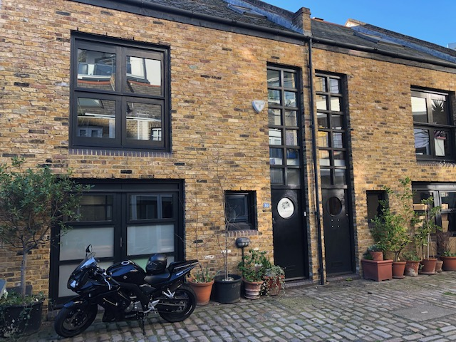
MODERN OFFICE TO LET
Tel: 07885 912 982
MEDIA DESIGN OFFICE
1,050 SQ FT
(97.5 SQM)
QUIET LOCATION
Insert an image here
10 WHITEHORSE MEWS, LONDON, SE1 7QD
APPROX. 1,050 SQ FT ( 97.5 SQM)
AVAILABLE 1st JULY 2019
RENT - £42,000 PER ANNUM

Slide 2
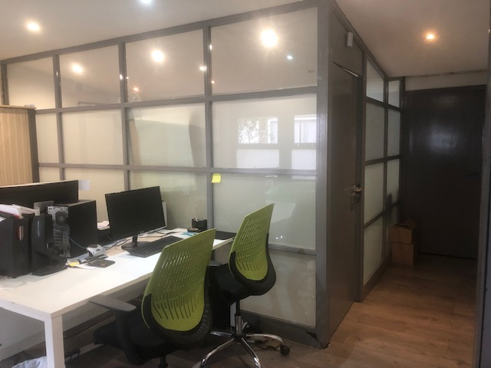
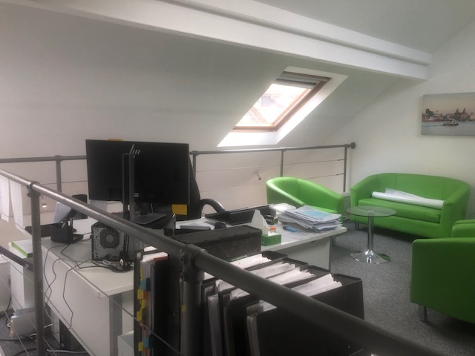
Tel: 07885 912 982
Description
Modern Mews house converted to provide character office accommodation arranged over the ground, first and second floors. There are two separate meeting rooms and an open plan office located on the first floor.
MISREPRESENTATION ACT 1967
Important: These particulars have been prepared as agent for our clients and are intended as a convenient guide to supplement an inspection or survey. They do not constitute any part of an offer or contract and their accuracy is not guaranteed. They contain statements of opinion and in some instances we have relied on information provided by others. You should verify the particulars on your visit to the property and the particulars do not obviate the need for a full survey and all of the appropriate enquiries. Accordingly, there shall be no liability as a result of any error or omission in the particulars or any other information given.

Slide 3
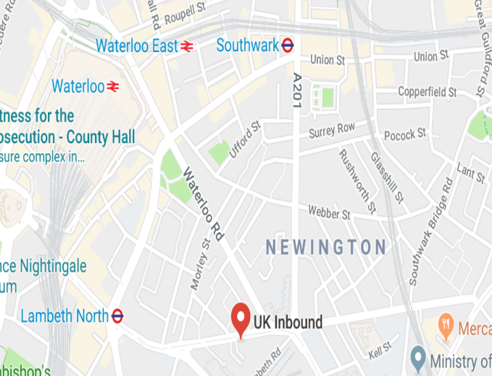
5 Risborough Street
Tel: 07885 912 982
Description
Forming part of similar period buildings within an attractive mews, the property is arranged over the ground, first and second floors benefitting from a reception room, open plan office and two meeting rooms.
Office specifications include:
Wood flooring (ground floor).
Gas central heating.
Recessed spotlighting.
2 x meeting rooms.
2 x tea-points.
2 x W.C facilities.
EPC
EPC asset rating = 114 (Band E).
MAP
Terms
A new FRI lease offered on terms by arrangement.
VAT
VAT is payable on the rent and service charge.
Location
The property is located just off Westminster Bridge Road (A3202) close to the junction with Gerridge Street towards St. George’s Circus.
Waterloo mainline and underground station is approximately 10 minutes walk. Alternatively Lambeth North (Bakerloo line) is approximately 6 minutes away.
Service Charge.
Approximately £400 per annum
excluding buildings insurance.
Rent
£ 42,000 per annum exclusive of all outgoings.
Rates
The Rateable Value for 2019/20 is £42,750. Therefore the rates payable is approximately £20,477 per annum.
Further Details
Ian Lim
Lim Commercial
E: ian@limcommercial.com
Tel: 07885 912 982
MISREPRESENTATION ACT 1967
Important: These particulars have been prepared as agent for our clients and are intended as a convenient guide to supplement an inspection or survey. They do not constitute any part of an offer or contract and their accuracy is not guaranteed. They contain statements of opinion and in some instances we have relied on information provided by others. You should verify the particulars on your visit to the property and the particulars do not obviate the need for a full survey and all of the appropriate enquiries. Accordingly, there shall be no liability as a result of any error or omission in the particulars or any other information given.

